Slide 1
Compliance as Code Lessons Learned from Regulated Organizations
#ossummit Sergiu Bodiu
2018 October Open Source Summit Europe

Slide 2
Agenda
About
DevOps keeps eating the world
Compliance as Code
Infrastructure as code
Continuous Compliance
Notes:
Thanks to the organizers
Let’s review the agenda for my talk

Slide 3
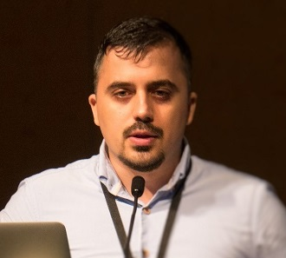
About Speakers
Architect. Building Communities. Developer. Speaker
Architect @Standard Chartered
ex-Pivotal,
ex-JP Morgan,
ex-Bank of America
ex-Adobe
Founder of Spring User Group Singapore
Organiser for DevOpsDays Singapore
https://www.devopsdays.org/events/2018-singapore
@Sergiu_Bodiu
https://www.linkedin.com/in/sergiubodiu/
Notes:
I’m currently working as the Global Cloud Architect at Standard Chartered
I’ve started contributing to open source about 10 years ago
I’ve started building communities of practice about 5 year ago, by creating Spring User Group

Slide 4
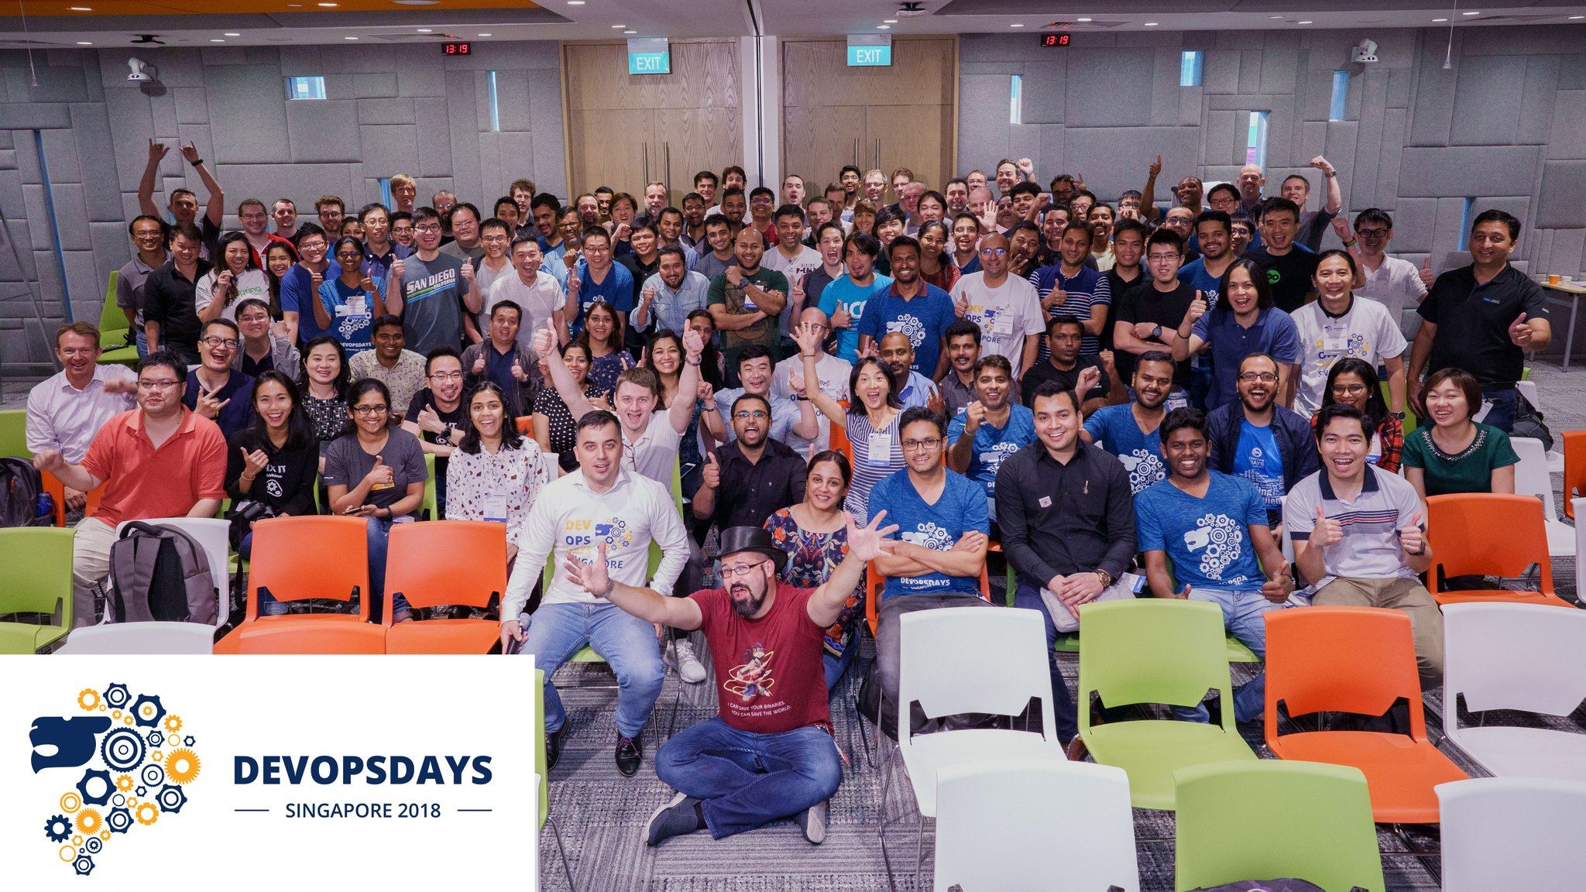
DevOps keeps eating the world
Infrastructure is a flexible resource

Slide 5
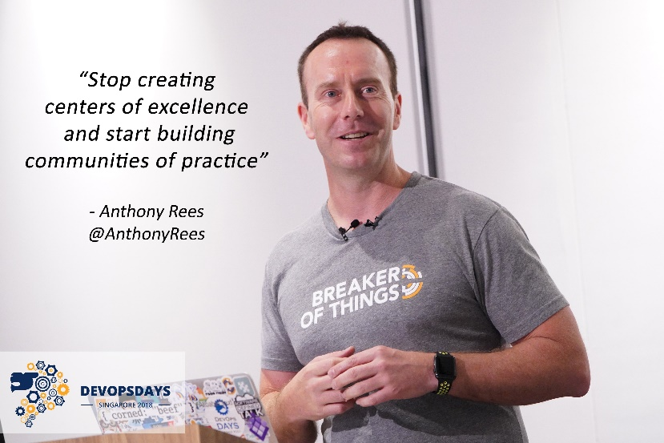
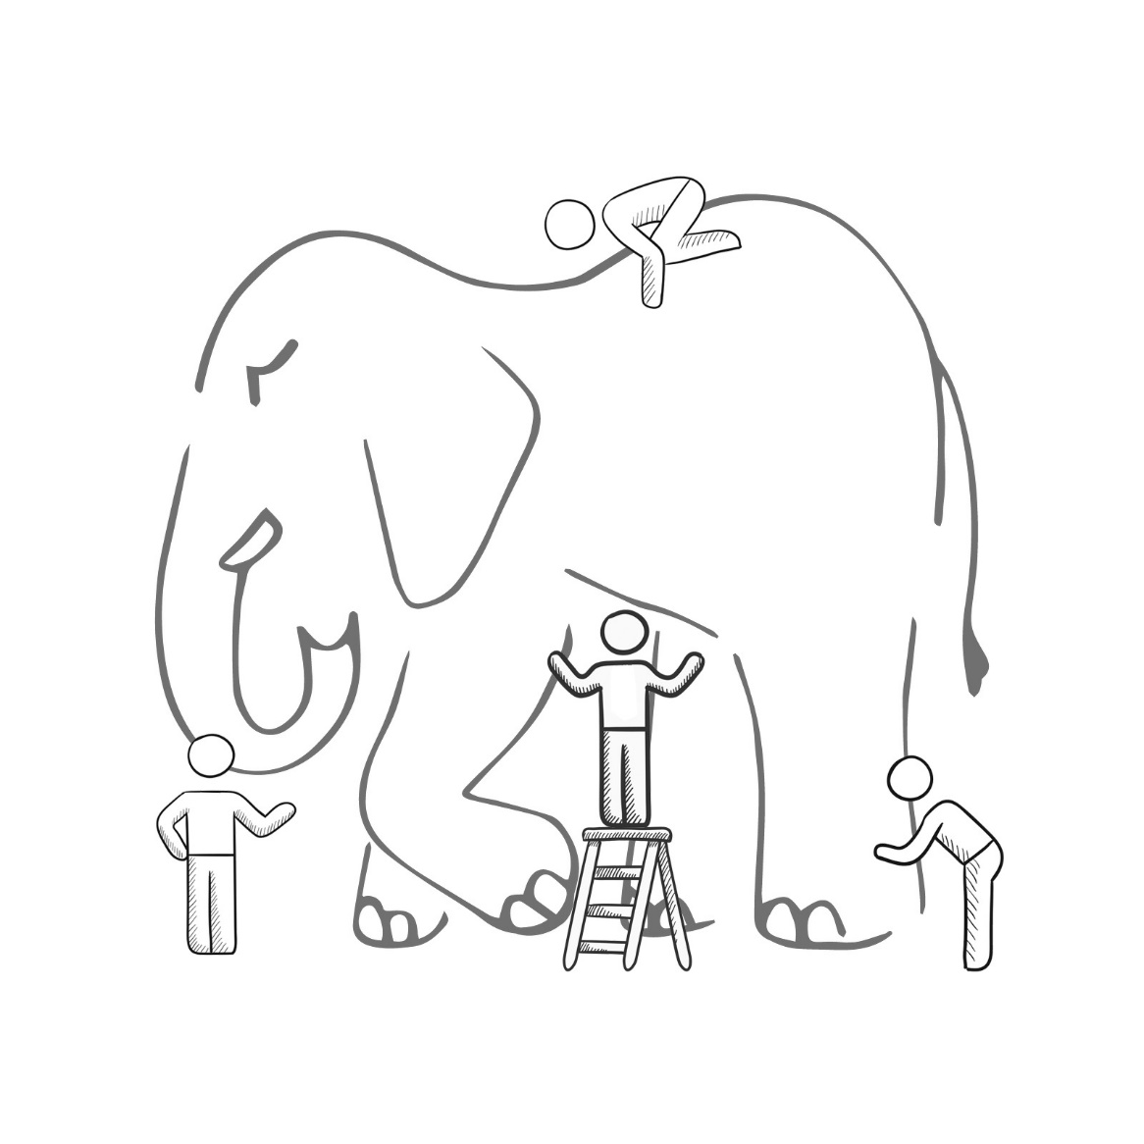
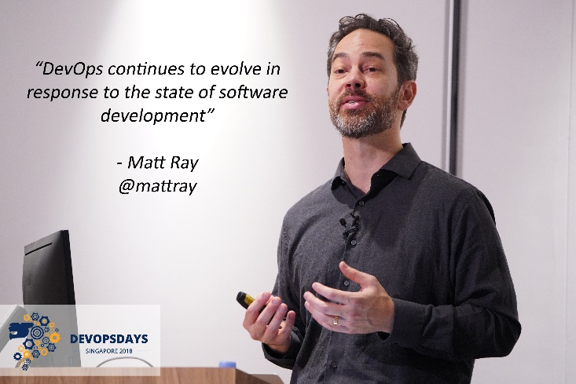
What is DevOps
It’s a job title
It’s automation
It’s Development and Operations collaboration
It means faster and smaller releases
7 Habits of Successful DevOps
Notes:
Stop creating centers of excellence and start building communities of practice
Don’t trust DevOps certificates and tooling, it continue to evolve in response to the state of software development

Slide 6
Agile Roles & Responsibilities
Tech. & Investment Governance
Solution Architect
Stakeholders
Secures funds and manages budgets
Manage collective activities, issues, and risks
Country level implementation and rollout
Overall architecture governance
Work collaborative with the team in the solution design
Define high level architecture design and principles
Are sponsors and impacted-teams
Have significant decision making authority
Ensure project alignment with business and technology strategy
Specialists
Release Team
Agile Coach
Deep understanding of specific disciplines
Bridge gaps in business and technical knowledge
Part of the agile team on need basis
Govern releases
Perform quality checks and provide approvals
Deploy to production
Helps teams to adopt and improve on Agile methods and practice
Help teams to adopt DevOps tools and practices including CI/CD

Slide 7
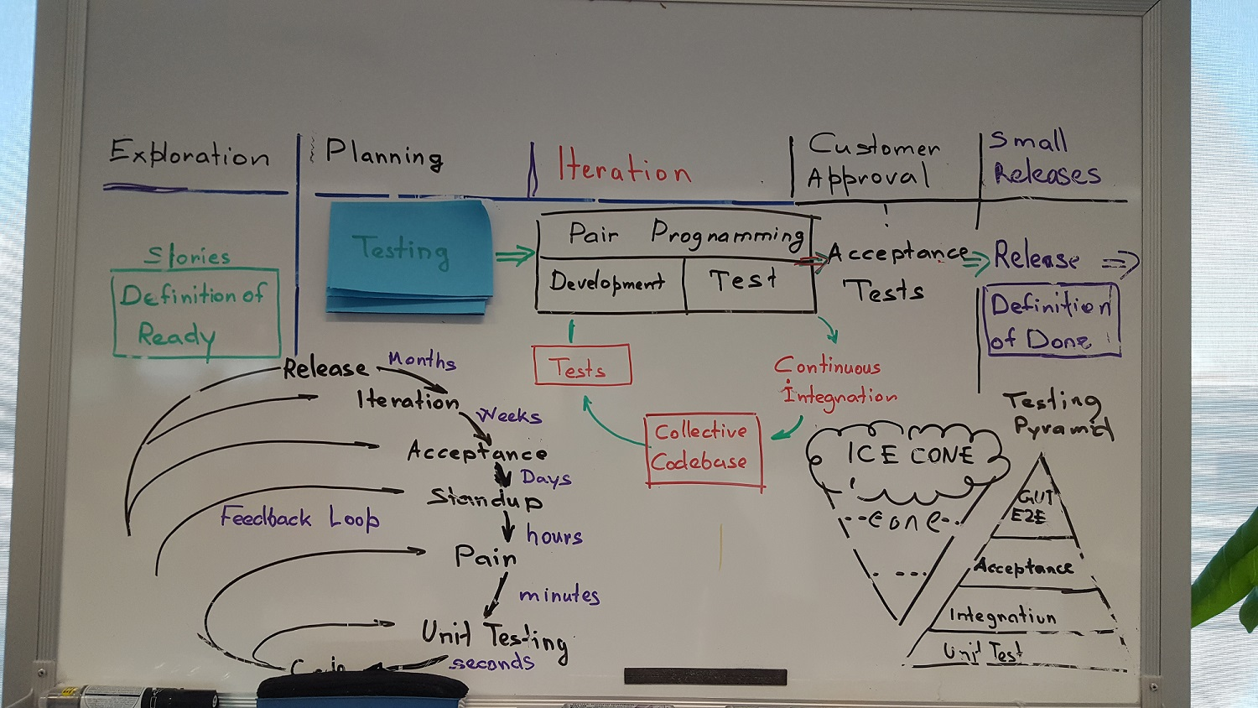

Slide 8
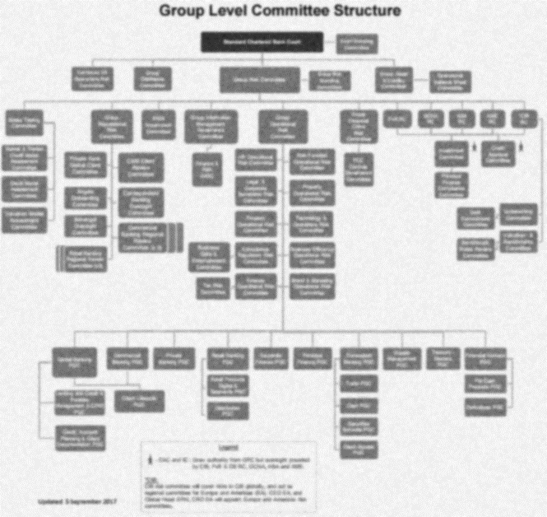
Governance Manual
IT Security Policy Program Management
IT Controls Assurance
Third Party Catalog
Issue Management

Slide 9
Compliance as Code
What security and compliance risks or obligations need to be address

Slide 10
AWS User Guide to Financial Services Regulations & Guidelines in Singapore
The following sections provide considerations for FIs as they assess their responsibilities with regards to the following guidelines:
MAS Guidelines on Outsourcing
MAS Technology Risk Management (TRM) Guidelines
Association of Banks in Singapore (ABS) Cloud Computing Implementation Guide
Notes:
The Guidelines on Outsourcing provide expanded guidance to the industry on prudent risk management practices for outsourcing, including cloud services.
These include guidance for a high level of reliability, availability and recoverability of critical IT systems and for FIs to implement IT controls to protect customer information from unauthorized access or disclosure.
ABS guide is intended to assist FIs in further understanding approaches to due diligence, vendor management and key controls that should be implemented in cloud outsourcing arrangements.

Slide 11
What are the challenges to migrate to cloud
What applications are suitable for migration to cloud ?
Is there sufficient business justification for migrating ?
What is the best technical approach for migrating?
What integration solutions are need to support an application on the cloud platform ?
What security and compliance risks or obligations need to be addressed ?
Migrating Application
to Hybrid Cloud Computing

Slide 12
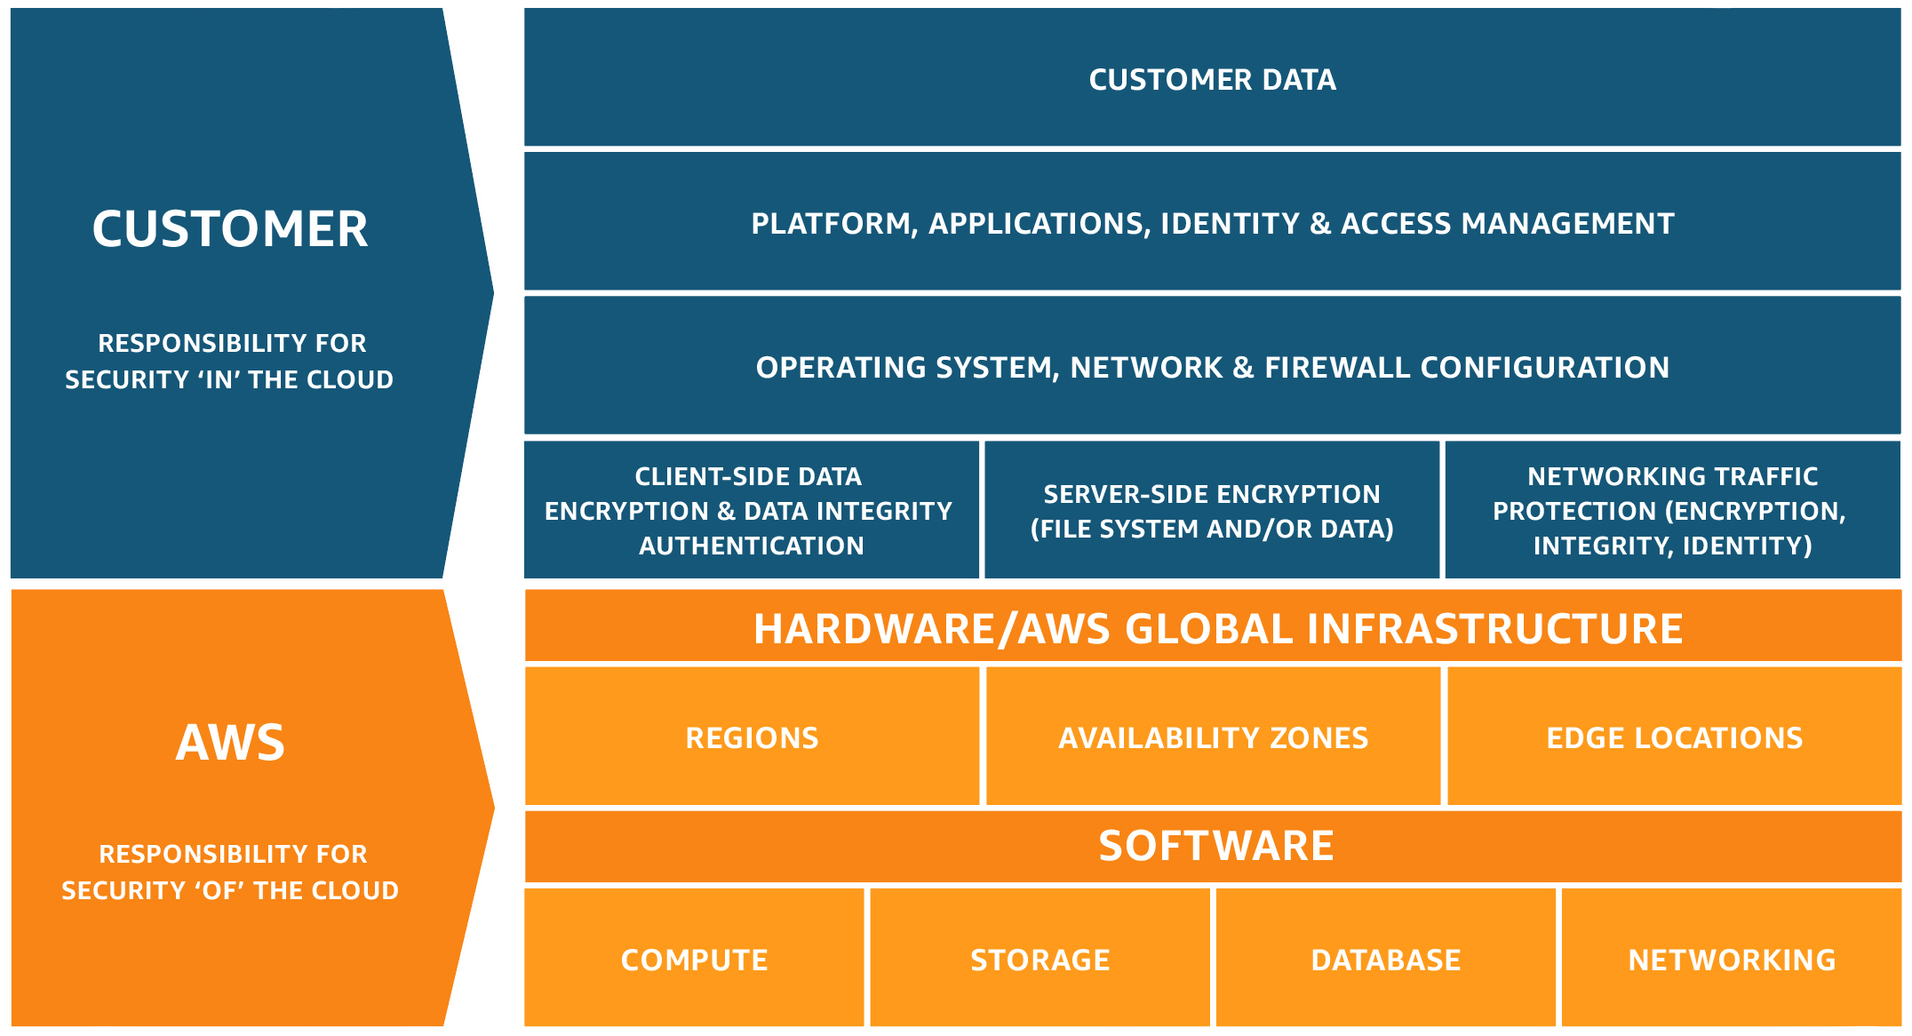
Customer responsibility “Security in the Cloud”

Slide 13
AWS Config - Overview
AWS Config
Monitors and records your AWS resource configurations. It also keeps track of relationships between resources
AWS Config Rules
Managed (pre-defined) or Custom-created rules that AWS periodically runs to evaluate your configuration to see if configuration is in compliance and provides action.
TLDR; Configuration management “lens” on your AWS resources that can be helpful in your control objectives.
https://github.com/awslabs/aws-config-rules

Slide 14
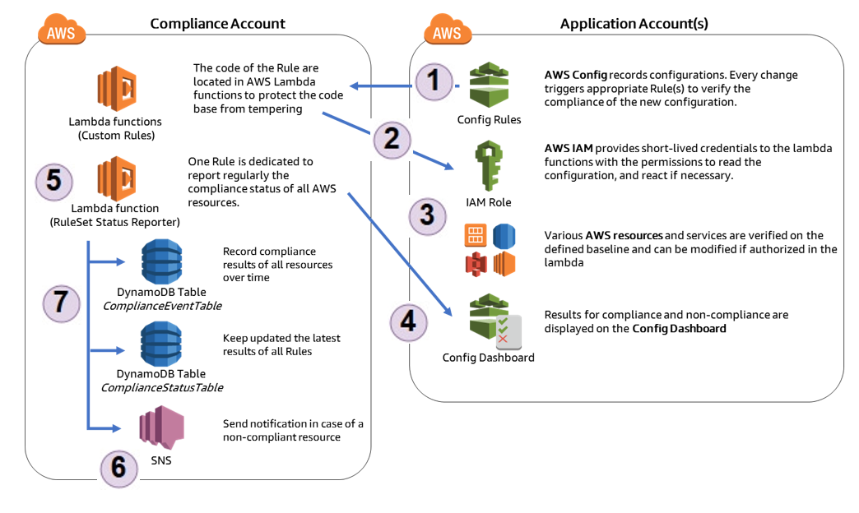
AWS Config
Notes:
1. Config triggers lambda at every change or on schedule.
2. Lambda assumes the appropriate IAM role to verify the configuration.
3. Lambda describe the appropriate resources to get the latest configuration state.
4. Lambda reports to Config Rules the results.
5. Lambda RuleSet Status Reporter is triggered every hour
6. Notify the account owner
7. All events are stored in database tables

Slide 15
Multi-factor authentication enabled (Lambda)
 | Benchmark | Security Control Resource Name
1 | Identity and Access Management
1.1 | Avoid the use of the "root" account | IAMRootActivityCloudWatchMetric
1.2 | Ensure multi-factor authentication (MFA) is enabled for all IAM users that have a console password | UsersMustHaveMfaEnabled
1.3 | Ensure credentials unused for 90 days or greater are disabled | DisableUnusedCredentials
1.4 | Ensure access keys are rotated every 90 days or less | DisableUnusedCredentials
1.5 | Ensure IAM password policy requires at least one uppercase letter | IamPasswordPolicyMustMeetRequirements
1.6 | Ensure IAM password policy require at least one lowercase letter | IamPasswordPolicyMustMeetRequirements
1.7 | Ensure IAM password policy require at least one symbol | IamPasswordPolicyMustMeetRequirements
1.8 | Ensure IAM password policy require at least one number | IamPasswordPolicyMustMeetRequirements
1.9 | Ensure IAM password policy requires minimum length of 14 or greater | IamPasswordPolicyMustMeetRequirements
1.10 | Ensure IAM password policy prevents password reuse | IamPasswordPolicyMustMeetRequirements
1.11 | Ensure IAM password policy expires passwords within 90 days or less | IamPasswordPolicyMustMeetRequirements
1.12 | Ensure no root account access key exists | RootAccoutMustHaveMfaEnabled
1.13 | Ensure MFA is enabled for the "root" account | RootAccoutMustHaveMfaEnabled
1.14 | Ensure hardware MFA is enabled for the "root" account | RootAccoutMustHaveMfaEnabled
1.15 | Ensure security questions are registered in the AWS account
1.16 | Ensure IAM policies are attached only to groups or roles | UsersMustNotHaveAssociatedPolicies
1.17 | Enable detailed billing
1.18 | Ensure IAM Master and IAM Manager roles are active
1.19 | Maintain current contact details
1.20 | Ensure security contact information is registered
1.21 | Ensure IAM instance roles are used for AWS resource access from instances | InstancesMustUseIamRoles
1.22 | Ensure a support role has been created to manage incidents with AWS Support
1.23 | Do not setup access keys during initial user setup for all IAM users that have a console password
1.24 | Ensure IAM policies that allow full "*:*" administrative privileges are not created | IamPoliciesMustNotContainStarStar
2 | Logging
2.1 | Ensure CloudTrail is enabled in all regions | CloudTrailMustBeActive
2.2 | Ensure CloudTrail log file validation is enabled | CloudTrailLogsMustBeValidatedAndEncrypted
2.3 | Ensure the S3 bucket CloudTrail logs to is not publicly accessible | CloudTrailBucketMustBeSecure
2.4 | Ensure CloudTrail trails are integrated with CloudWatch Logs | CloudTrailMustBeActive
2.5 | Ensure AWS Config is enabled in all regions | ConfigMustBeEnabledInAllRegions
2.6 | Ensure S3 bucket access logging is enabled on the CloudTrail S3 bucket | CloudTrailBucketMustBeSecure
2.7 | Ensure CloudTrail logs are encrypted at rest using KMS CMKs | CloudTrailLogsMustBeValidatedAndEncrypted
2.8 | Ensure rotation for customer created CMKs is enabled | KmsCustomerKeysMustBeRotated
def IAM_1_2_root_mfa_enabled():
iam = STS_SESSION.client("iam")
response = iam.get_account_summary()
if response['SummaryMap']['AccountMFAEnabled'] != 1:
status = 'NON_COMPLIANT'
else:
status = 'COMPLIANT'
config = STS_SESSION.client("config")
config.put_evaluations(
Evaluations=[
{
"ComplianceResourceType": "AWS::::Account",
"ComplianceResourceId": "Root MFA enabled",
"ComplianceType": status,
"OrderingTimestamp": str(datetime.now())
},
],
ResultToken=result_token
)
https://github.com/awslabs/aws-config-engine-for-compliance-as-code
Notes:
If you want to design Security and Compliance as first class citizens
- AWS Config is not portable to Private Cloud
- The Lambda rules are cumbersome and not readable by non-tech person, we have only 10 controls
- We can’t leverage any framework or controls library profile

Slide 16
PCI DSS compliance and Shared Responsibility
 | PCI DSS Requirement | AWS | Cloud User
1 | Install and maintain a firewall configuration to protected cardholder data | Shared | Shared
2 | Do not use vendor-supplied defaults for password or other security parameters | Shared | Shared
3 | Protect stored cardholder data | Shared | Shared
4 | Encrypt transmission of cardholder data across open, public networks |  | 
5 | Protect al systems against malware and regularly update AV software/programs |  | 
6 | Develop and maintain secure systems and applications | Shared | Shared
7 | Restrict access to cardholder data by business need to know | Shared | Shared
8 | Identify and authenticate access to system components | Shared | Shared
9 | Restrict physical access to cardholder data | 
10 | Track and monitor all access to network resources and cardholder data | Shared | Shared
11 | Regularly test security systems and processes | Shared | Shared
12 | Maintain a policy that addresses info security for all personnel | Shared | Shared

Slide 17
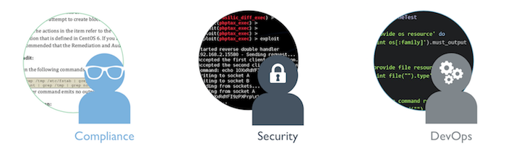
InSpec: Inspect Your Infrastructure
InSpec is a run-time framework and rule language used to specify compliance, security, and policy requirements. It includes a collection of resources that help you write auditing controls quickly and easily.
Turn your compliance, security, and other policy requirements into automated tests.
Notes:
We need a Spec-like framework that has human readable rules that BA, STS, Compliance and ITO can review, edit and maintain. We need to be able to execute this rules for capturing Preventive + Detective controls.
InSpec (VulcanoSpec acquisition is a 5 years mature OSS project) it has been adopted by major cloud providers and On-premise providers.

Slide 18
InSpec sample rules
describe aws_ iam_user(name: ‘sergiubodiu’) do
its(‘has_mfa_enabled?’) { should be false }
its(‘has_console_password?’) { should be true }
end
describe aws_iam_access_key(username: ‘username’, id: ‘access-key id’) do
it { should exist }
it { should exist }
its(‘created_date’) { should be > Time.now -365 * 86400 }
its(‘last_used_date’) { should be > Time.now -365 * 86400 }
end
describe aws_iam_password_policy do
its (‘requires_lowercase_letters?’) {should be true }
its (‘requires_uppercase_letters?’) {should be true }
end
https://github.com/chef/inspec
Notes:
We’re still investigating how Inspec may fit our technology stack

Slide 19
Cloud Risk and Security Concerns
Regulatory Obligations
Statutory and Contractual Obligations
Authorisation, Authentication and Entitlements
Data Confidentiality and Privacy
Data Residency
Data Sovereignty
Outsourcing Obligations
The Right to Audit
Notes:
Security and compliance are often topics that present the greatest barriers to cloud adoption. Many of the same concerns exist with internally hosted systems and traditional IT outsourcing, but the concerns are often amplified with cloud computing because the resources used to deliver cloud services are shared across many cloud customers with limited transparency of the underlying systems.
Teams stress the minimum part of MVP to the exclusion of the viable part.
The product delivered is not sufficient quality to provide an accurate assessment of whether customers will use the product.
Teams deliver what they consider an MVP, and then do not do any further changes to that product, regardless of feedback they receive about it.

Slide 20
Enable governance with pipelines
Compliance Specifications
Acceptance
Tests
Environment
Definitions
Every change
Is logged and traceable
Pipeline Definitions
Controls Library
Notes:
80% to 90% of modern apps consist of assembled components. Utilizing billions of parts from open source communities...
Equifax from a customer perspective.

Slide 21
Code Testing History
1994: Kent Beck writes the SUnit testing framework for Smalltalk (source)
1998: article on Extreme Programming mentions that "we usually write the test first" (source)
1998 to 2002: "Test First" is elaborated into "Test Driven", in particular on the C2.com Wiki
2000: Mock Objects are among the novel techniques developed during that period (source)
2003: publication of "Test Driven Development: By Example" by Kent Beck
2003: agiledox, the ancestor of BDD, is a tool generating technical documentation automatically from JUnit tests, written by Chris Stevenson
2004: in order to test his hypotheses about de-emphasizing "test" terminology in favor of "behavior", Dan North releases JBehave
2006: in collaboration with Chris Matts, North proposes the given-when-thencanvas to expand the scope of BDD to business analysis and documents the approach in "Introducing BDD"
2006-2009: several new tools are released confirming the community's investment in BDD, such as RSpec or more recently, Cucumber and GivWenZen
https://www.agilealliance.org/glossary/tdd

Slide 22
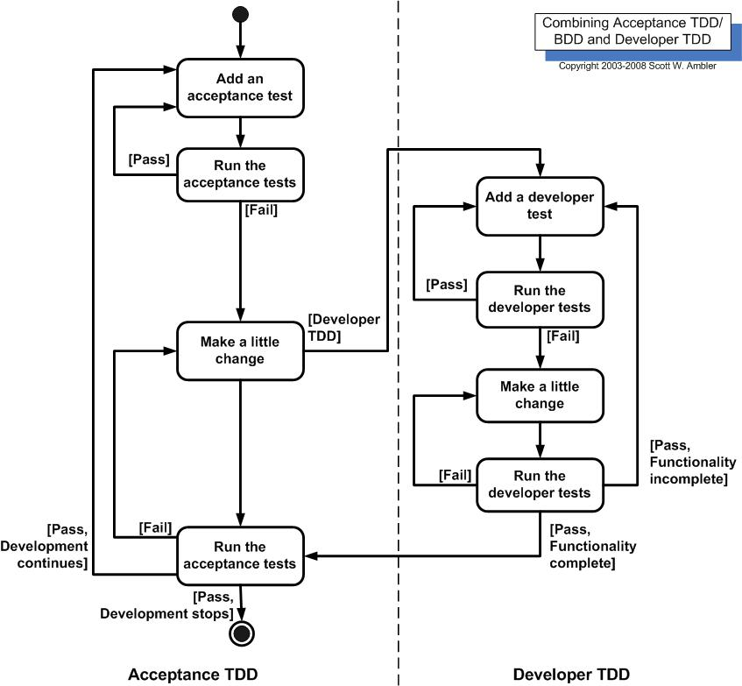
How acceptance TDD and developer TDD work

Slide 23
Flexible Infrastructure
Developer sandboxing
Cloud dev/test labs
Containerization
Microservices
Autoscaling
Failover
Notes:
Cloud infrastructure allows us to provision infinite resources on-demand, something that is impossible with traditional on-premises infrastrucuture.
This has enabled us to implement many innovative DevOps practices with minimal capital outlay and only pay for what we use.

Slide 24
Infrastructure as Code is born
Infrastructure Automation: CFengine, Puppet, and Chef
The essence of Infrastructure as Code is to treat the configuration of systems the same way source code is treated. Source code management (SCM) systems, TDD, CI, Refactoring, and other XP practices are especially useful for making sure that changes to infrastructure are thoroughly tested, repeatable, and transparent.
From the Iron Age to the Cloud Age
It uses techniques, practices, and tools from software development to ensure those actions are thoroughly tested before being applied to business critical systems.
(Infrastructure as Code - Kief Morris)
Notes:
Configuration management tools–like Chef, Puppet, or Ansible–can automate the remediation of compliance violations and InSpec allows you to automate the assessment.

Slide 25
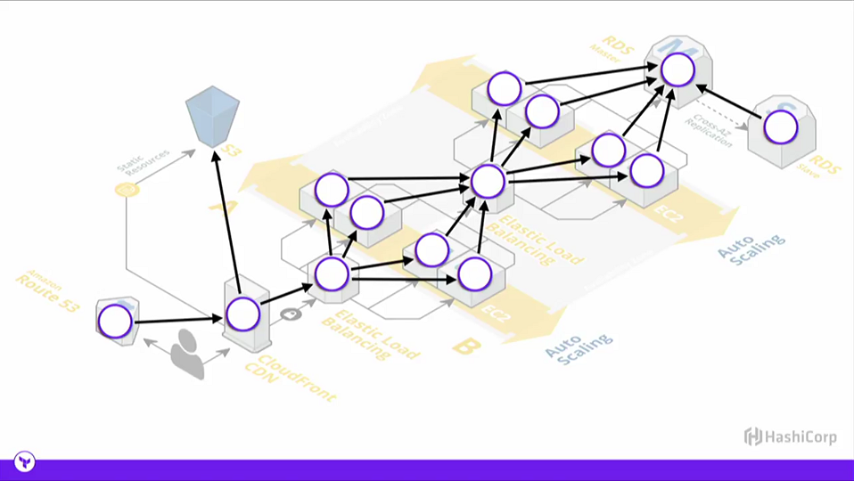
Write, Plan, and Create Infrastructure as Code
Directed graph representing dependencies of several objects towards each other.
- Wikipedia
Applying Graph Theory to Infrastructure As Code
Notes:
“A dependency graph is a directed graph representing dependencies of several objects towards each other. It is possible to derive an evaluation order or the absence of an evaluation order that respects the given dependencies from the dependency graph. ” - Wikipedia

Slide 26
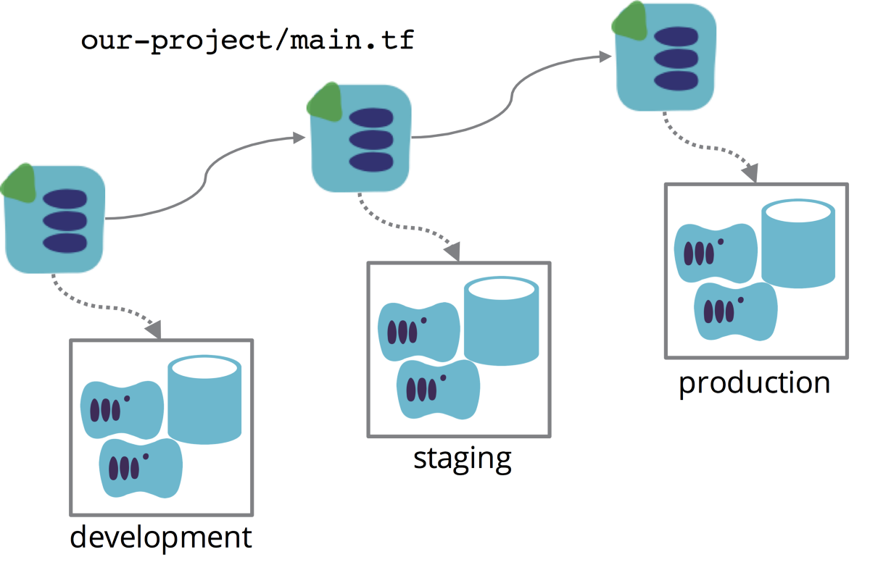
Each environment has its own stack instance use CD pipeline to promote a stack definition across environments
http://infrastructure-as-code.com/book/2017/08/02/environment-pipeline.html

Slide 27
Streamline & Centralise information required
Eliminate duplicates entry of information and ensuring consistency
Streamline approval process to ensure all regulatory requirements have been reviewed
Transparency of information and approval process
Centralised ITO know-how/expertise
Centralised inventory of 3rd party to identify concentration risk
Centralised information for Audit (internal, external, regulatory)
Reduce time for renewal of engagements

Slide 28
Continuous Compliance
Next generation Platforms

Slide 29
Acceptance Test
GIVEN a code repository
AND a set of approved design patterns
WHEN a new valid design specification file is committed
AND the file is analyzed against the approved patterns
THEN the design is approved
AND future releases can go to the pre-production environment

Slide 30
Adoption Governance
“As an Application owner, I want to standardize the *NFR* for my applications running on the Cloud.
Can rely upon solely steering in-flight Projects to Cloud
Provide next generation software-driven facilities
Requires detailed Portfolio and Architecture analysis
Thorough understanding of dependencies and sequencing.
Formal forecasting, commitments at a very senior level.
And provision of funding for adoption (or elimination).
Training new skills

Slide 31
IaaS CaaS PaaS FaaS
Application
Application
Application
Functions
Customer Managed
Data
Data
Data
Data + Application
Unit of Scale
Runtime
Containers (Optional)
Runtime
Runtime
Containers (Optional)
Runtime
Containers (Optional)
Delivered as a Service
Containers
Legend
Operating System
Operating System
Operating System
Operating System
Virtualization
Virtualization
Virtualization
Virtualization
Hardware
Hardware
Hardware
Hardware
Notes:
Multiple financial-services firms have adopted strategy to increase IT Outsourcing activities, particularly the use of third party technology Cloud Solutions which includes:
Infrastructure as a Service (IaaS)
Platform as a Service (PaaS)
Software as a Service (SaaS) - vs the traditional hosting of on-premise software.
If we take an example of AWS as Cloud Service Provider, we have services that cross the boundaries, you can solve the same problem with 5-6 solution.
We need to rack and stack the hardware in our Data Center connect power supply, connect networking, connect storage and pass certifications. Standard Chartered is in 55 jurisdictions, imagine that we will have to create a private data centre in each of this regions.
We install the operating systems and setup an IaaS to expose VMs to end users. In terms of platform we have the choice to install it on an abstraction level provided by our IaaS or directly on Bare Metal.
In terms of our actual application portfolio we have it everywhere, we have applications that are latency sensitive and hence will be installed on Bare Metal, we would have some Platform as a Services, Containers as a Service or Functions as a Service.

Slide 32
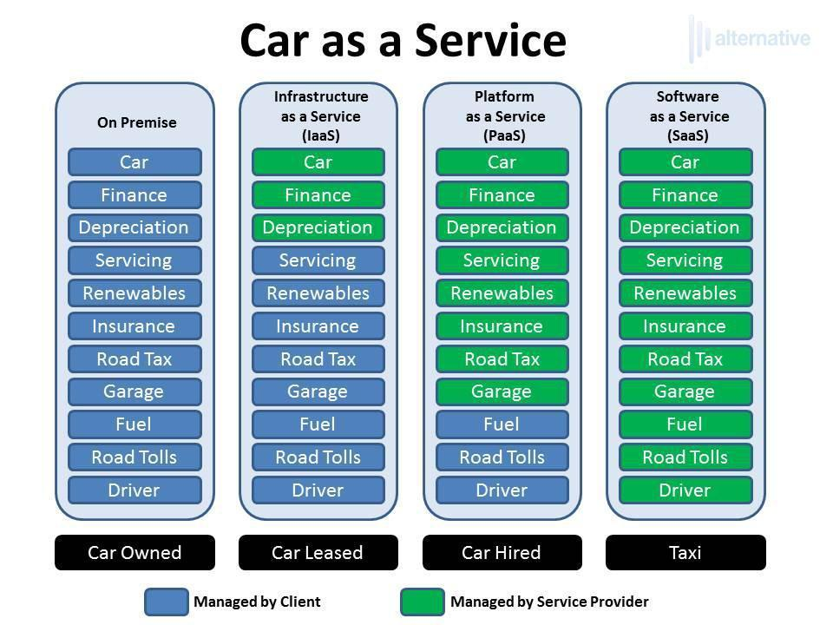
Car as a Service Analogy
Notes:
Cloud computing is like the user hiring a taxi. Scalability is there: as you can call as many taxis as you want. Flexibility is there: as you can drop them anytime, anywhere if your plans change.
You only pay for the distance you travel so it’s pay as you go. Booking them is easier and you can do that by yourself.
You are not responsible for maintenance of rental cars.

Slide 33
Governance, Risk & Compliance Approach
Baseline Evaluation
Gap analysis
Minimal viable cloud service
Ongoing assurance
Regulatory compliance
Notes:
Clearly understand the regulatory and legal obligations for data and software that are to be migrated to a cloud service and develop a suitable GRC model to ensure these statutory obligations are met. The GRC model should consider the following areas.

Slide 34
AWS Provisioner that runs InSpec tests in the DevSec baselines.
resource "aws_instance" "web" {
connection {
user = "ubuntu"
}
instance_type = "t2.micro"
ami = "${lookup(var.aws_amis, var.aws_region)}"
vpc_security_group_ids = ["${aws_security_group.default.id}"]
subnet_id = "${aws_subnet.default.id}"
key_name = "inspec"
provisioner "inspec" {
profiles = [
"supermarket://dev-sec/linux-baseline",
"supermarket://dev-sec/ssh-baseline",
]
on_failure = "continue"
}
tags {
Name = "HelloCompliance"
}
}
https://github.com/inspec/terraform-provisioner-inspec
# connects as user ubuntu
# ssh key
# installs inspec and executes the profiles
# allow pass if compliance errors happen
# compliance tags

Slide 35
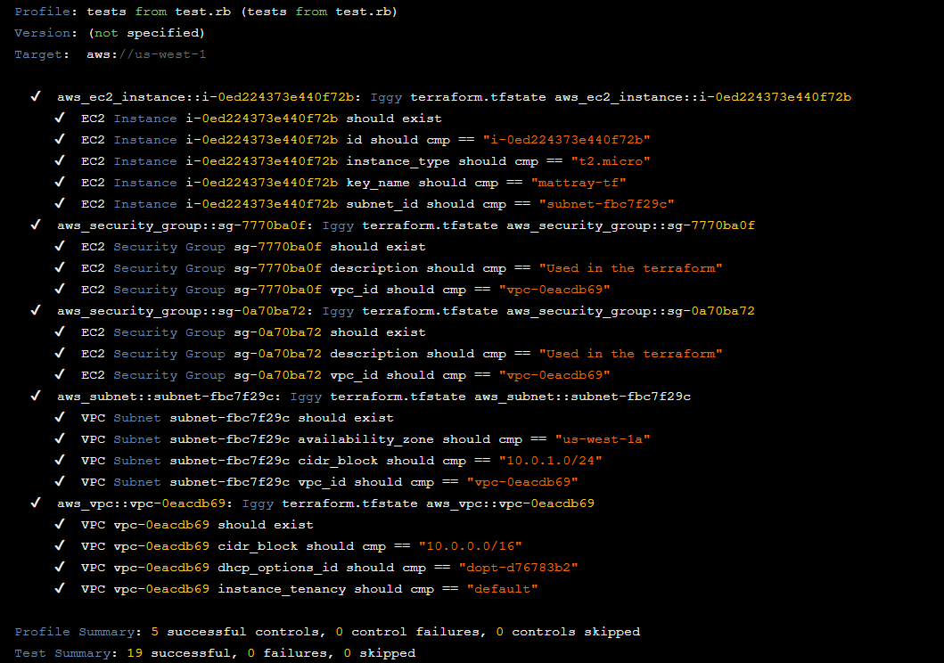
https://blog.chef.io/2018/05/23/automatically-generating-inspec-controls-from-terraform/

Slide 36
Packer Workflow
Docker
Build
Provision
Post-Process
VirtualBox
Application
Images
VMWare
AWS EC2
Notes:
Multiple financial-services firms have adopted strategy to increase IT Outsourcing activities, particularly the use of third party technology Cloud Solutions which includes:
Infrastructure as a Service (IaaS)
Platform as a Service (PaaS)
Software as a Service (SaaS) - vs the traditional hosting of on-premise software.
If we take an example of AWS as Cloud Service Provider, we have services that cross the boundaries, you can solve the same problem with 5-6 solution.
We need to rack and stack the hardware in our Data Center connect power supply, connect networking, connect storage and pass certifications. Standard Chartered is in 55 jurisdictions, imagine that we will have to create a private data centre in each of this regions.
We install the operating systems and setup an IaaS to expose VMs to end users. In terms of platform we have the choice to install it on an abstraction level provided by our IaaS or directly on Bare Metal.
In terms of our actual application portfolio we have it everywhere, we have applications that are latency sensitive and hence will be installed on Bare Metal, we would have some Platform as a Services, Containers as a Service or Functions as a Service.

Slide 37
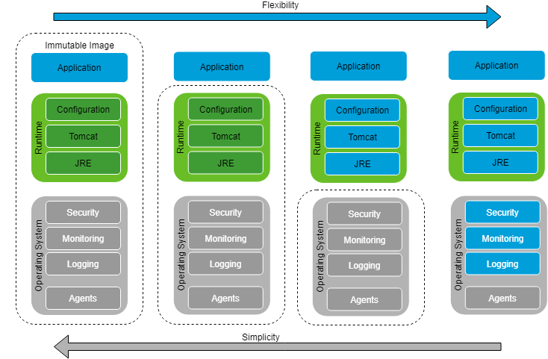
Immutable Images Flexibility vs Simplicity

Slide 38
Four Abstractions of Cloud Native Operations
Functions
Operational Efficiency
Opinions
Applications
Service Brokers
Containers

Slide 39
Why automate?
Continuous monitoring
Continuous assessment
Audit and Compliance
Change management
Operational troubleshooting
Guardrails
Visibility
Control
Audit
Logs
Alarm
Reme-diate
Notes:
Continuous compliance is a methodology for automating assessment and remediation of compliance policy with separation of duties for each part of that management cycle.
What makes this automation “continuous” is moving beyond ad-hoc manually driven periodic assessments and remediation events.

Slide 40
Questions?
Thank you
@Sergiu_Bodiu
https://www.linkedin.com/in/sergiubodiu/

Slide 41
Improve Flow of Customer Value
Continuous Integration
Continuous Deployment
Release Management
Automated Testing

Slide 42
WE ARE HIRING
System Engineers and Software Engineers

Slide 43
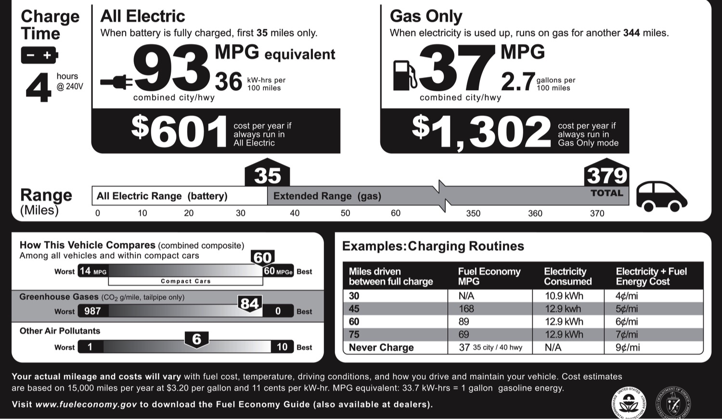
Cost per mile
Notes:
The Architecture and Opportunity behind the Cloud
Total gas for the year: $2,400
Maintenance, using AAA averages: $739.50
Tires: $163.50
Full coverage insurance: $1,006
License, registration, taxes:$769
Depreciation: $5,091
Finance charges: $1,089
Total cost for the year : $11,258

Slide 44
Common Terms
Term | Definition
Cloud (Computing) | On-demand delivery of IT resources via broad network access with rapid elasticity, resource pooling, and measured service.
Container | An isolated user-space instance created by OS-level virtualization. Make it easier to package and deploy applications by treating the Container as a unit of software delivery
IaaS | Self service model for provisioning and utilizing compute, storage and networking and resources in a pay-as-you-go model, on a service basis without any upfront commitment.
PaaS | A platform for the development or running of applications by providing a development framework that abstracts much of the underlying infrastructure and operating system
SaaS | Cloud service model where a vendor provided application is accessed remotely, usually over the internet, by the customer. The entire application-infrastructure stack and operations is managed by the vendor, usually in a multi-tenant configuration.

Slide 45
What is Governance and Compliance
Governance is the oversight role and the process by which firms manage and mitigate risks.
IT Governance is defined as the processes that ensure the effective and efficient use of IT in enabling an organization to achieve its goals
Compliance ensures that an organization has the process and internal controls to meet the requirements imposed by the governance body.

Slide 46
Common Terms
Term | Definition
Re-architect | Major changes to the application and/or infrastructure architecture leveraging the capabilities and services offered by the target platform
Re-factor | Minor changes to application and/or infrastructure architecture to consume services where available on the target platform to replace existing functionality, e.g. replace database server with database services, hardware load balancer with load balancer service
Re-host | ‘Lift & shift’ a virtual machine from on-premises infrastructure to target platform without significant changes, typically only updates to OS drivers
Re-install | Install the application and dependencies into a new virtual machine, this could include an OS upgrade
Re-platform | A major change to an application during a move from on-premises infrastructure to AWS, typically includes porting to a different processor architecture or changing underlying database architecture

Slide 47
AWS CIS Benchmark
 | Benchmark | Profile Level | Scored | Automated | Security Control Type | Security Control Resource Name
1 | Identity and Access Management
1.1 | Avoid the use of the "root" account | 1 | Yes | Yes | CloudWatch Alarm | IAMRootActivityCloudWatchMetric
1.2 | Ensure multi-factor authentication (MFA) is enabled for all IAM users that have a console password | 1 | Yes | Yes | Config Rule | UsersMustHaveMfaEnabled
1.3 | Ensure credentials unused for 90 days or greater are disabled | 1 | Yes | Yes | CloudWatch Rule (scheduled) | DisableUnusedCredentials
1.4 | Ensure access keys are rotated every 90 days or less | 1 | Yes | Yes | CloudWatch Rule (scheduled) | DisableUnusedCredentials
1.5 | Ensure IAM password policy requires at least one uppercase letter | 1 | Yes | Yes | Config Rule | IamPasswordPolicyMustMeetRequirements
1.6 | Ensure IAM password policy require at least one lowercase letter | 1 | Yes | Yes | Config Rule | IamPasswordPolicyMustMeetRequirements
1.7 | Ensure IAM password policy require at least one symbol | 1 | Yes | Yes | Config Rule | IamPasswordPolicyMustMeetRequirements
1.8 | Ensure IAM password policy require at least one number | 1 | Yes | Yes | Config Rule | IamPasswordPolicyMustMeetRequirements
1.9 | Ensure IAM password policy requires minimum length of 14 or greater | 1 | Yes | Yes | Config Rule | IamPasswordPolicyMustMeetRequirements
1.10 | Ensure IAM password policy prevents password reuse | 1 | Yes | Yes | Config Rule | IamPasswordPolicyMustMeetRequirements
1.11 | Ensure IAM password policy expires passwords within 90 days or less | 1 | Yes | Yes | Config Rule | IamPasswordPolicyMustMeetRequirements
1.12 | Ensure no root account access key exists | 1 | Yes | Yes | Config Rule | RootAccoutMustHaveMfaEnabled
1.13 | Ensure MFA is enabled for the "root" account | 2 | Yes | Yes | Config Rule | RootAccoutMustHaveMfaEnabled
1.14 | Ensure hardware MFA is enabled for the "root" account | 2 | Yes | Yes | Config Rule | RootAccoutMustHaveMfaEnabled
1.15 | Ensure security questions are registered in the AWS account | 1 | No | No
1.16 | Ensure IAM policies are attached only to groups or roles | 1 | Yes | Yes | Config Rule | UsersMustNotHaveAssociatedPolicies
1.17 | Enable detailed billing | 1 | Yes | No
1.18 | Ensure IAM Master and IAM Manager roles are active | 1 | Yes | No
1.19 | Maintain current contact details | 1 | Yes | No
1.20 | Ensure security contact information is registered | 1 | Yes | No
1.21 | Ensure IAM instance roles are used for AWS resource access from instances | 2 | No | Yes | Config Rule | InstancesMustUseIamRoles
1.22 | Ensure a support role has been created to manage incidents with AWS Support | 1 | Yes | No
1.23 | Do not setup access keys during initial user setup for all IAM users that have a console password | 1 | No | No
1.24 | Ensure IAM policies that allow full "*:*" administrative privileges are not created | 1 | Yes | Yes | Config Rule | IamPoliciesMustNotContainStarStar
2 | Logging
2.1 | Ensure CloudTrail is enabled in all regions | 1 | Yes | Yes | Config Rule | CloudTrailMustBeActive
2.2 | Ensure CloudTrail log file validation is enabled | 2 | Yes | Yes | Config Rule | CloudTrailLogsMustBeValidatedAndEncrypted
2.3 | Ensure the S3 bucket CloudTrail logs to is not publicly accessible | 1 | Yes | Yes | Config Rule | CloudTrailBucketMustBeSecure
2.4 | Ensure CloudTrail trails are integrated with CloudWatch Logs | 1 | Yes | Yes | Config Rule | CloudTrailMustBeActive
2.5 | Ensure AWS Config is enabled in all regions | 1 | Yes | Yes | Config Rule | ConfigMustBeEnabledInAllRegions
2.6 | Ensure S3 bucket access logging is enabled on the CloudTrail S3 bucket | 1 | Yes | Yes | Config Rule | CloudTrailBucketMustBeSecure
2.7 | Ensure CloudTrail logs are encrypted at rest using KMS CMKs | 2 | Yes | Yes | Config Rule | CloudTrailLogsMustBeValidatedAndEncrypted
2.8 | Ensure rotation for customer created CMKs is enabled | 2 | Yes | Yes | Config Rule | KmsCustomerKeysMustBeRotated

